Slide 1

Shelf Management

Slide 2
CONTENTS
The problem
Defining the solution
System architecture
Data model
References

Slide 3

The problem
S
Managing inventory in retail stores, especially in larger establishments where there are many products and shelves to keep track of, can be a complicated and time-consuming process. In order to streamline this task, it is important to have a robust and efficient system in place to monitor stock availability and provide real-time insights and alerts about stock levels and product placement.

Slide 4
SOLUTION
the Shelf Management System will automate the process of tracking inventory and alerting the retail store if items are running low or have been mislaid. The system will gather data from multiple sources such as barcode scanning, manual entry, IoT sensors and stock availability data, to provide real-time insights into stock levels and item placement. Furthermore, the system will analyze historical data to uncover patterns and trends, make predictions about future stock levels, and identify opportunities for improved inventory management. Additionally, the system will leverage machine learning algorithms to predict when popular items are likely to run out of stock, allowing the store to restock them proactively to always meet customer demands.
S

Slide 5
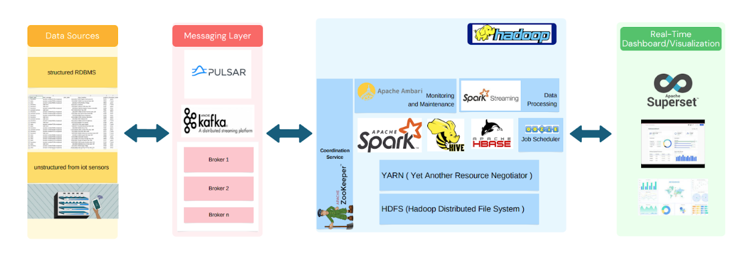
System architecture

Slide 6
01
02
The architecture would involve the following steps :
Data Collection
The system would collect key-value pairs such as (product ID, product_quantity_from_iot) and (product ID, product_location_from_iot) from IoT sensors, barcode scanning, and manual entry.
Data Ingestion
The collected data would then be ingested into Apache Spark for processing.

Slide 7
03
04
The architecture would involve the following steps :
Data Storage
The processed data would be stored in scalable data storage solutions, such as Apache HBase for unstructured data and Apache Hive for structured data.
Data Processing
The data would be cleansed and engineered to improve its quality, and Spark MLlib would be used to process the data and identify patterns and trends in stock availability and item placement.

Slide 8
05
06
The architecture would involve the following steps :
Real-time Streaming
Apache Kafka would be used to collect and store real-time data streams, and Apache Spark Streaming would be used to process the data in real-time.
Data Analysis
Machine learning algorithms, data mining, and statistical analysis would be used to perform deeper analysis on the processed data to uncover hidden insights and trends.

Slide 9
07
08
The architecture would involve the following steps :
Alerts and Notifications
The system would send alerts and notifications to retail stores if items are running low or misplaced, using Apache Pulsar for real-time delivery.
Data Visualization
Apache Superset would be used to visualize the processed data and provide insights into stock levels and item placement.

Slide 10
09
10
The architecture would involve the following steps :
Security and Privacy
The system would implement security measures such as encryption, access controls, and data masking to protect the data.
Disaster Recovery
A disaster recovery plan would be in place using HDFS replication factor 3 copies to minimize downtime and ensure business continuity.

Slide 11
11
The architecture would involve the following steps :
Monitoring and Maintenance
The system would be regularly monitored and maintained using Apache Ambari to keep it running smoothly and prevent issues from arising.

Slide 12
Data model
The Shelf Management System is designed to provide a comprehensive view of products and shelves in retail stores and ensure they are fully stocked with the right products. To achieve this, the system uses two types of data models, structured and unstructured data.

Slide 13
Data model
Step 1
Step 2
Structured Data Storage
The structured data, including product information, shelf information, and alerts generated by the system, would be stored in Apache Hive, a data warehousing and analytics platform. This data is stored in a structured manner to allow for efficient querying and analysis.
Unstructured Data Storage
The unstructured data, such as real-time product quantity and location from IoT sensors, would be stored in Apache HBase, a distributed NoSQL database. HBase stores the real-time data from IoT sensors and provides real-time insights into stock levels and item placement

Slide 14
Data model
Step 3
Step 4
Combining Structured and Unstructured Data
The Shelf Management System uses both structured and unstructured data to provide a comprehensive view of the products and shelves. The key-value pairs (product ID, product_quantity_from_iot) and (product ID, product_location_from_iot) are used to track the stock availability and location of the products and to generate alerts if necessary.
Real-Time Insights and Alerts
The combination of structured and unstructured data provides real-time insights into stock levels and item placement and ensures that the shelves are fully stocked with the right products. The Shelf Management System generates alerts for low stock levels or misplaced items using both structured and unstructured data.

Slide 15
Data model
Step 5
Integration with Other Systems
The Shelf Management System can also be linked to other systems, such as the Point of Sale (POS) system, for seamless integration and real-time updates on inventory and sales data.

Slide 16
References
[1]“How big data can improve inventory management,” The BigCommerce Blog, 10-May-2022. [Online]. Available: https://www.bigcommerce.com/blog/data-inventory-management/. [Accessed: 10-Feb-2023].
[2]P. Rupareliya, “How retailers are leveraging Big Data for marketing,” Medium, 17-Feb-2022. [Online]. Available: https://medium.com/intuz/how-retailers-are-leveraging-big-data-for-marketing-c0d1318207c1. [Accessed: 10-Feb-2023].
[3]M. Lawson, “What is real-time inventory management and Why is it vital?,” Digital Transformation Solutions, 24-Dec-2020. [Online]. Available: https://www.columbusglobal.com/en-gb/blog/what-is-real-time-inventory-management-and-why-is-it-vital#:~:text=Real%2Dtime%20inventory%20management%20is,quickly%20to%20supply%20chain%20needs. [Accessed: 10-Feb-2023].
[4] S. Srivastava, “How can data analytics help improve inventory optimization in retail?,” Appinventiv, 05-Sep-2022. [Online]. Available: https://appinventiv.com/blog/inventory-optimization-with-data-analytics/. [Accessed: 10-Feb-2023].
[5]ligz08, “Learn-Bigdata-Udemy/hive notes.md at master · Ligz08/Learn-Bigdata-Udemy,” GitHub, 06-Aug-2018. [Online]. Available: https://github.com/ligz08/learn-bigdata-udemy/blob/master/Hive%20Notes.md. [Accessed: 10-Feb-2023].
[6]V. R. says: “HBase architecture: HBase Data Model: Hbase read/write,” Edureka, 18-Nov-2022. [Online]. Available: https://www.edureka.co/blog/hbase-architecture/. [Accessed: 10-Feb-2023].
[7]“Community providers” Community Providers - Faker 16.8.1 documentation. [Online]. Available: https://faker.readthedocs.io/en/master/communityproviders.html. [Accessed: 10-Feb-2023].

Slide 17
Thank You
Monerah Almobarak - 442002988
Nada Alotaibi - 442003374
Sarah Aljuhani - 442000786
Sarah Altaweel -442005104

